Slide 1
XPN Energy Corp. Inventory Analysis
Udy Akpan
Sanjay Jha
Abhijit Patnaik
Alex Hill

Slide 2
Project Plan
Introduction
Identified Problem
Purpose and Scope
Objectives and Planned Outcomes
Data Review (Existing Methods)
Proposed System Components and Working Process
Mathematical Models and Analysis
Results
Implementation Plan

Slide 3
Introductions
Name of Stakeholder | Designation | Department | Role in Project | Type of Stakeholder | Type of Communication | Expectations | Interests | Influence on Project Outcome
Udy Akpan | Team Leader | Project Management | Organization | Primary | Teleconferencing, email | On-time deliverables | Organization | Ensures on-time delivery of project tasks and quality assurance
Abhijit Patnaik | Data Scientist | Engineering | Programming | Periphery | Email | Defined objectives | Technical expertise | Responsible for building the required tools as outlined by the business units
Sanjay Jha | Information Analyst | Analytics | Model Building | Periphery | Email, phone | Clean and accessable data | Machine learning | Build dynamic and predictive models that maximize efficiencies
Alex Hill | Market Research | Marketing/Sales | Reporting | Periphery | Email, phone | Clear business goals | Visualization | Provide insight and technical knowledge based on various perti

Slide 4
Purpose & Scope
Are there significant patterns in inventory demand which can be identified and modelled to predict an accurate inventory stocking level for high value fast moving items?
How can we predict items with a high likelihood of being understocked or overstocked?
How can we predict optimal inventory levels?
What are the factors which cause overstocking and understocking?
Insights into the underlying causes for overstocking and understocking can enable the management to develop appropriate strategies to minimize risk to operation.
What model deployment strategy would make for easier stock reviews with the right reporting and analysis tools?

Slide 5
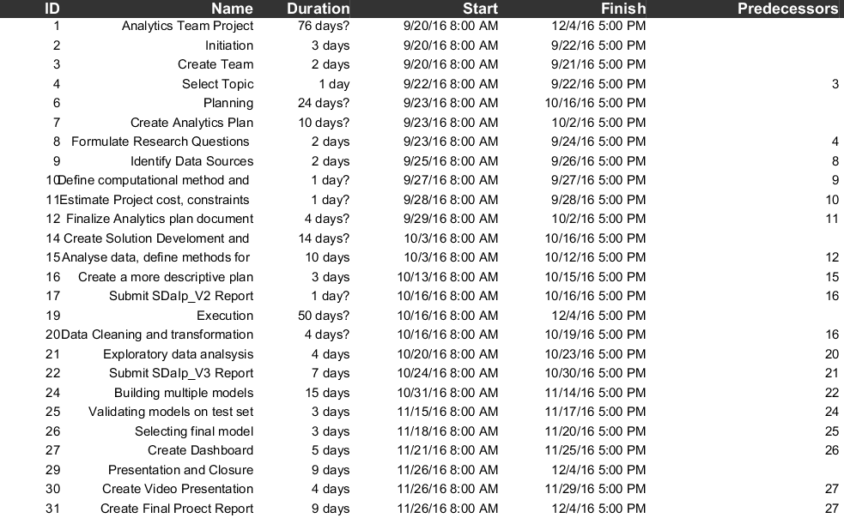
Project Schedule

Slide 6
Issue Tree
Annual inventory write-offs are costing the company millions of $$ on a yearly basis
Inaccuracies in the set minimum stock levels and reorder quantities configured in the procurement ordering system
No demand forecasting is currently done which is a key input into the computation of the minimum and reorder quantities
End-Users do not carry out the recommended annual stock reviews to provide an input into the annual procurement plan
Projects buying too much inventory
Inadequate material estimating methods used in projects
Operation planning teams inflate needed material quantities
Unusually long lead times
Operations planning teams do not reliably forecast the inventory quantities they will consume each year
Format of the current stock review report is not user-friendly
The items in red represent the strategies we will pursue in this project

Slide 7
Data Review
Goods Movement Report
Fast Mover Review
Data Retrieval and Integration
Issues and Quality Review
Data Cleaning & Munging
Statistical Measurements

Slide 8
Goods Movement Reports

Slide 9
Fast Mover Review

Slide 10
Data Retrieval and Integration

Slide 11
Issues and Quality Review

Slide 12
Data Cleaning & Munging

Slide 13
Statistical Measurements

Slide 14
Proposed System & Working Process
Communication Plan
SAP Inventory Management System
Dashboard Review

Slide 15
Communication Plan
Scrum Meeting type | Purpose | Frequency
Sprint planning | Identify the features to be worked and establish the requirements and objectives for the next sprint | Every 2 weeks
Daily Scrum | Daily team meetings lasting for 15 mins to catch up on project progress and to identify and resolve any issues | Daily
Sprint review | A time set apart to demonstrate to the customer, the features worked on during the recently concluded Sprint | Every 2 weeks
Sprint Retrospective | A time set apart to reflect on the previous sprint and to identify specific steps that can be taken to improve subsequent sprints | Every 2 weeks

Slide 16
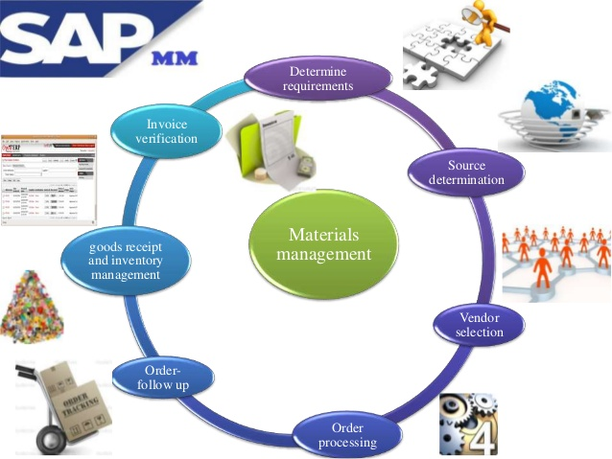
SAP Inventory Management System

Slide 17
SAP Inventory Management System (cont’d)
Requirements - Materials requirements are determined at the Materials planning department.
Source – The various sources of material supply can be determined based on past orders and any purchase agreement with vendor. Purchase requisition can be sent automatically via SAP EDI, if the vendor is setup in the system.
Vendor Selection – The system can automatically compare the quotation from the vendors and approve/reject it based on criteria.
Purchase Order Processing – Purchasing module retrieves information from requisition and quotation to create purchase order.
Order follow-up – Depending on the expected delivery target and reminder frequency, the system generates reminders for follow-up.
Inventory Management – Inventory management person can acknowledge good receipt and enter the relevant details in the system.
Invoice verification – this module handles invoice validations against purchase order.

Slide 18
Dashboard Review

Slide 19
Mathematical Models and Analysis
Computational Methods
Time-Series Analysis
Decision Tree
Linear Regression Modeling
Logistic Regression Modeling
Neural Networks
Testing and Evaluation

Slide 20
Computational Methods
Hardware: 4 core PCs with 8 GB ram
Programming Language: R
Method | R Library/Function
Multiple Regression | lm()
Moving Averages | forecast/ma()
Exponential Smoothing | forecast/ses()
STL Decomposition | forecast/stl()
Holt-Winters Seasonal Method | forecast/stl()
ARIMA | forecast/Arima()
Dynamic Regression Models | forecast/Arima()
Neural Network Auto Regression Models | forecast/nnetar()

Slide 21
Time-Series Analysis

Slide 22
Decision Tree

Slide 23
Linear Regression Modeling

Slide 24
Logistic Regression Modeling

Slide 25
Neural Networks

Slide 26
Testing and Evaluation

Slide 27
Appendix
R-Code
Backup Graphs & Figures

Slide 28
R Code

Slide 29
Backup Graphs and Figures

